Slide 1
toString: converting an integer value into a String
Task: Convert an integer value to a string
Example: intToString(5137) should return the string "5137"
Insight: intToString(5137) = intToString(513) + "7"
Recursive algorithm for toString(x):
Base case:
if x < 10 return the string "" + x
Reduction:
(we arrive here if x has n > 1 digits)
return the string toString(first n-1 digits of x) + lastDigitOf(x)
string concatenation

Slide 2
toString: converting an integer value into a String
toString(5137)
א
"5137"
ח
return toString(513) + 7
ב
"513"
ז
Recursive algorithm for toString(x):
Base case:
if x < 10 return the string "" + x
Reduction:
(we arrive here if x has n > 1 digits)
return the string toString(first n-1 digits of x) + lastDigitOf(x)
return toString(51) + 3
ג
"51"
ו
return toString(5) + 1
ד
"5"
ה
return "5"
string concatenation
Actual code: homework

Slide 3
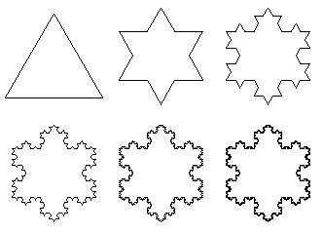
Snowflakes
n = 1
n = 2
n = 3
n = 4
n = 5
n = 6
Fractal drawing logic
Describe some simple drawing rule
Apply the rule recursively
Example: Koch curve
(the contour of the snowflakes is constructed using a Koch curve).

Slide 4
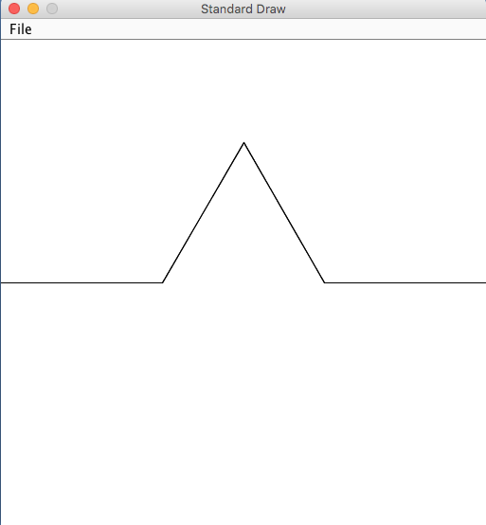
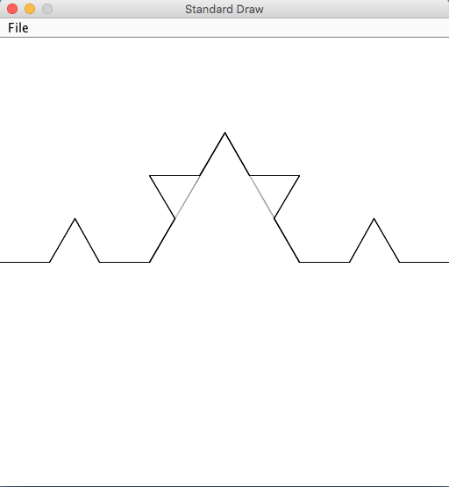
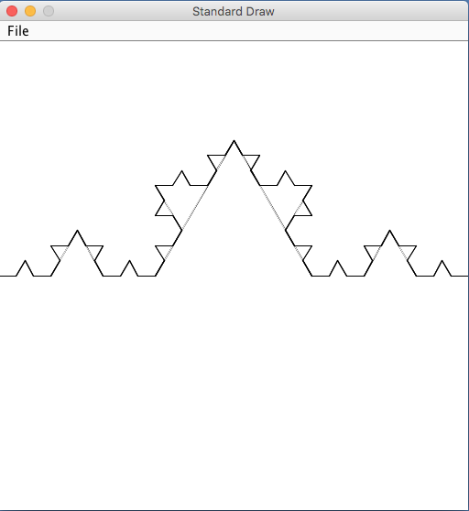
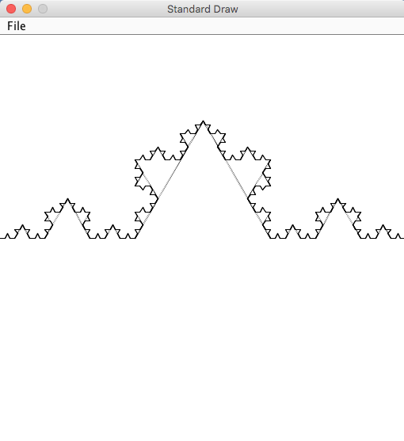
Koch curve
% java Test 1
% java Test 2
% java Test 3
% java Test 4
Drawing a Koch curve between points p1 and p2:
1. divide the line (p1,p2) into three equal segments
2. compute points a, b, c (equilateral triangle)
3. remove (a,b)
4. draw (a,c) and (b,c)
draw a Koch curve between p1 and a
draw a Koch curve between a and c
draw a Koch curve between c and b
draw a Koch curve between b and p2
. . .
c
p1
a
b
p2

Slide 5
Point class (revisited)
// import std.StdDraw;
/** Represents a 2D point. */
public class Point {
The solution of the last problem in this lecture uses object-oriented programming (OOP).
We’ll return to this problem after we learn OOP.

Slide 6
Point class (revisited)
// import std.StdDraw;
/** Represents a 2D point. */
public class Point {
private double x;
private double y;
/** Constructs a point. */
public Point(double x, double y) {
this.x = x;
this.y = y;
}
/** Accessors */
public double x() { return x; }
public double y() { return y; }
/** Draws a line between this point with the other one, using the given color. */
public void drawLine(Point other, Color color) {
StdDraw.setPenColor(color);
StdDraw.line(x, y, other.x, other.y);
}
/** Draws a line between this point with the other one, using black color. */
public void drawLine(Point other) {
drawLine(other, StdDraw.BLACK);
}
}
Same as the Point class,
Except that the drawLine method can take a color parameter
Colors: StdDraw.BLACK, StdDraw.WHITE, StdDraw.RED, etc.

Slide 7
Koch curve
public static void test() {
// Draws a Koch curve from (0.0,0.5) to (1.0,0.5)
kochCurve((new Point(0.0,0.5)), (new Point(1.0,0.5)), 2);
}
c
p1
a
b
p2

Slide 8
Koch curve
public static void test() {
// Draws a Koch curve from (0.0,0.5) to (1.0,0.5)
kochCurve((new Point(0.0,0.5)), (new Point(1.0,0.5)), 2);
}
public static void kochCurve(Point p1, Point p2, int n) {
// Draws a line segment between p1 and p2
p1.drawLine(p2);
if (n > 0) {
// Computes points a, b, c
Point a = new Point(((2 * p1.x() + p2.x()) / 3),((2 * p1.y() + p2.y()) / 3));
Point b = new Point(((2 * p2.x() + p1.x()) / 3),((2 * p2.y() + p1.y()) / 3));
double h = (Math.sqrt(3) / 2.0) * (1.0 / 3.0);
Point c = new Point((h * (p1.y() - p2.y()) + (p1.x() + p2.x()) / 2),
(h * (p2.x() - p1.x()) + (p1.y() + p2.y()) / 2));
// Removes the middle segment
a.drawLine(b,StdDraw.WHITE);
// Draws the two edges of the equilateral triangle
a.drawLine(c);
b.drawLine(c);
// Repeat the procedure on each one of the 4 segments
kochCurve(p1, a, n-1);
kochCurve(a, c, n-1);
kochCurve(c, b, n-1);
kochCurve(b, p2, n-1);
}
}
c
p1
a
b
p2

Slide 9
Koch curve
public static void test() {
// Draws a Koch curve from (0.0,0.5) to (1.0,0.5)
kochCurve((new Point(0.0,0.5)), (new Point(1.0,0.5)), 4);
}
public static void kochCurve(Point p1, Point p2, int n) {
// Draws a line segment between p1 and p2
p1.drawLine(p2);
if (n > 0) {
// Computes points a, b, c
Point a = new Point(((2 * p1.x() + p2.x()) / 3),((2 * p1.y() + p2.y()) / 3));
Point b = new Point(((2 * p2.x() + p1.x()) / 3),((2 * p2.y() + p1.y()) / 3));
double h = (Math.sqrt(3) / 2.0) * (1.0 / 3.0);
Point c = new Point((h * (p1.y() - p2.y()) + (p1.x() + p2.x()) / 2),
(h * (p2.x() - p1.x()) + (p1.y() + p2.y()) / 2));
// Removes the middle segment
a.drawLine(b,StdDraw.WHITE);
// Draws the two edges of the equilateral triangle
a.drawLine(c);
b.drawLine(c);
// Repeat the procedure on each one of the 4 segments
kochCurve(p1, a, n-1);
kochCurve(a, c, n-1);
kochCurve(c, b, n-1);
kochCurve(b, p2, n-1);
}
}

